Slide 1

A Snapshot into Predicting Airline Delays in the U.S.
Project 4 - Northwestern Data Science Bootcamp 2022
By Connor Grant, Alfredo Garcia, Yousuf Amin AlFatwa, & Neel Patel

Slide 2
Description
The U.S. Department of Transportation's (DOT) Bureau of Transportation Statistics tracks the on-time performance of domestic flights operated by large air carriers. Summary information on the number of on-time, delayed, canceled, and diverted flights is published in DOT's monthly Air Travel Consumer Report and in this dataset of 2015 flight delays and cancellations..
We used this dataset to find out whether a delay prediction can be made for future flights based on Airline, Airport locations, Departure and Arrival TIme, Delays by various causes (Securit, Weather, Airline, etc…)
Factors explored in our data for predictions included differing airlines, departure and arrival airports, the day of week, and the month.
The data that we examined is composed of more categorical data and as a results of that, we predicted Random Forest Classifier would be a stronger model compared to Logistic Regression model.

Slide 3
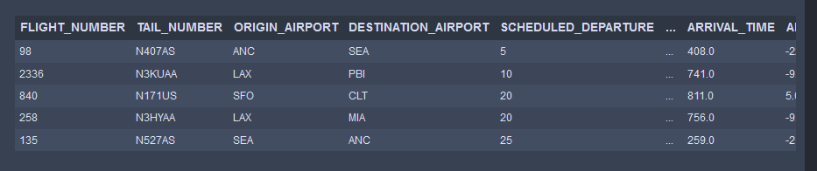
Data Source
https://www.kaggle.com/datasets/usdot/flight-delays
Data is collected and published by the Department of Transportation’s Bureau of Transportation Statistics.
Data consists of the whole year but it was condensed to 6 months to run the models.
5.8 million rows of data was examined with this dataset.
flights.csv
YEAR | DEPARTURE TIME & DELAY
MONTH | TAXI IN & OUT
DAY | CANCELLATION REASON
DAY_OF_WEEK | AIR_SYSTEM_DELAY
AIRLINE | SECURITY_DELAY
FLIGHT_NUMBER | AIRLINE_DELAY
TAIL_NUMBER | WEATHER_DELAY
ORIGIN_AIRPORT | AIR_TIME
DESTINATION_AIRPORT | DISTANCE
airports.csv
IATA_CODE
AIRPORT
CITY
STATE
COUNTRY
LATITUDE
LONGITUDE
airlines.csv
IATA_CODE
AIRLINE

Slide 4







Technologies Used
Python - Pandas (Jupyter Notebook)
Supervised Machine Learning - SKLearn
Seaborn
Matplotlib
HTML / CSS / Bootstrap
Javascript
Flask
Tableau

Slide 5








Airlines
IATA_CODE | AIRLINE | IATA_CODE | AIRLINES
UA | United Airlines (515,723) | NK | Spirit Airlines (117,379)
AA | American Airlines (725,984) | WN | Southwest Airlines (1,261,855)
US | US Airways (198,715) | DL | Delta Airlines (875,881)
F9 | Frontier Airlines (90,836) | EV | Atlantic Southeast Airlines (571,977)
B6 | JetBlue Airways (267,048) | HA | Hawaiian Airlines (76,272)
OO | SkyWest Airlines (588,353) | MQ | American Eagles Airlines (294,632)
AS | Alaska Airlines (172,521) | VX | Virgin America (61,903)

Slide 6
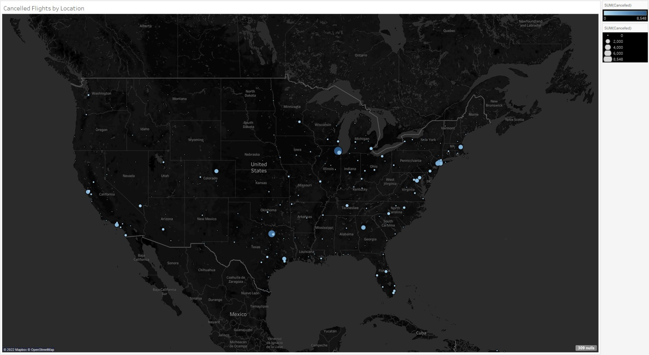
Tableau
50 States, 308 Cities totaling to 322 Airports examined
14 Airline Companies
5,819,079 rows and 31 columns examined

Slide 7
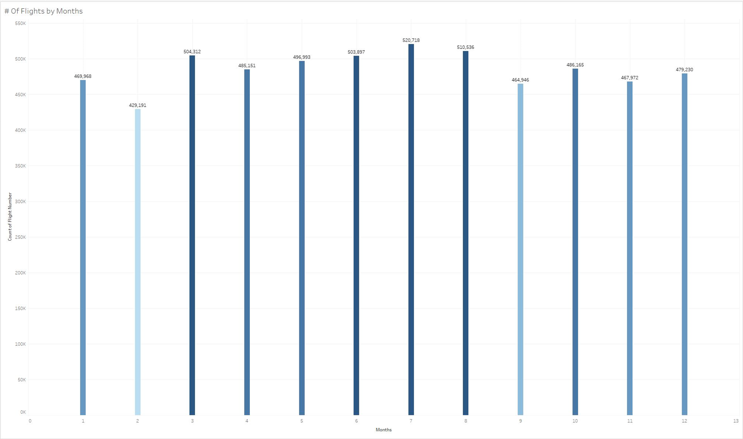

Slide 8
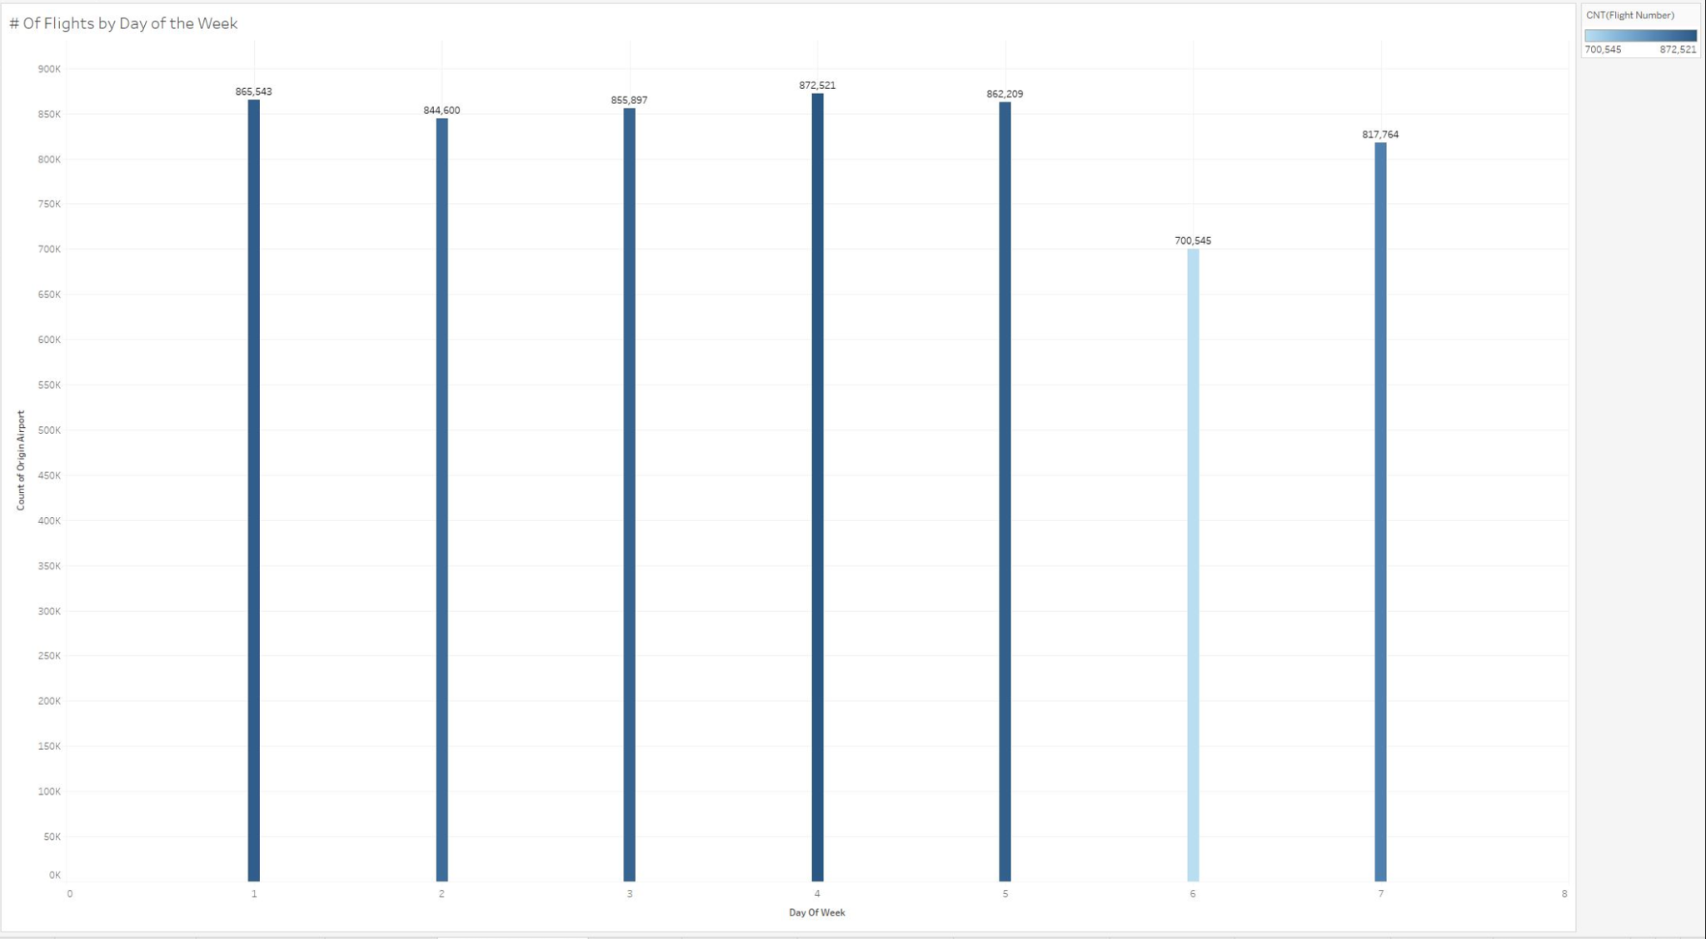

Slide 9
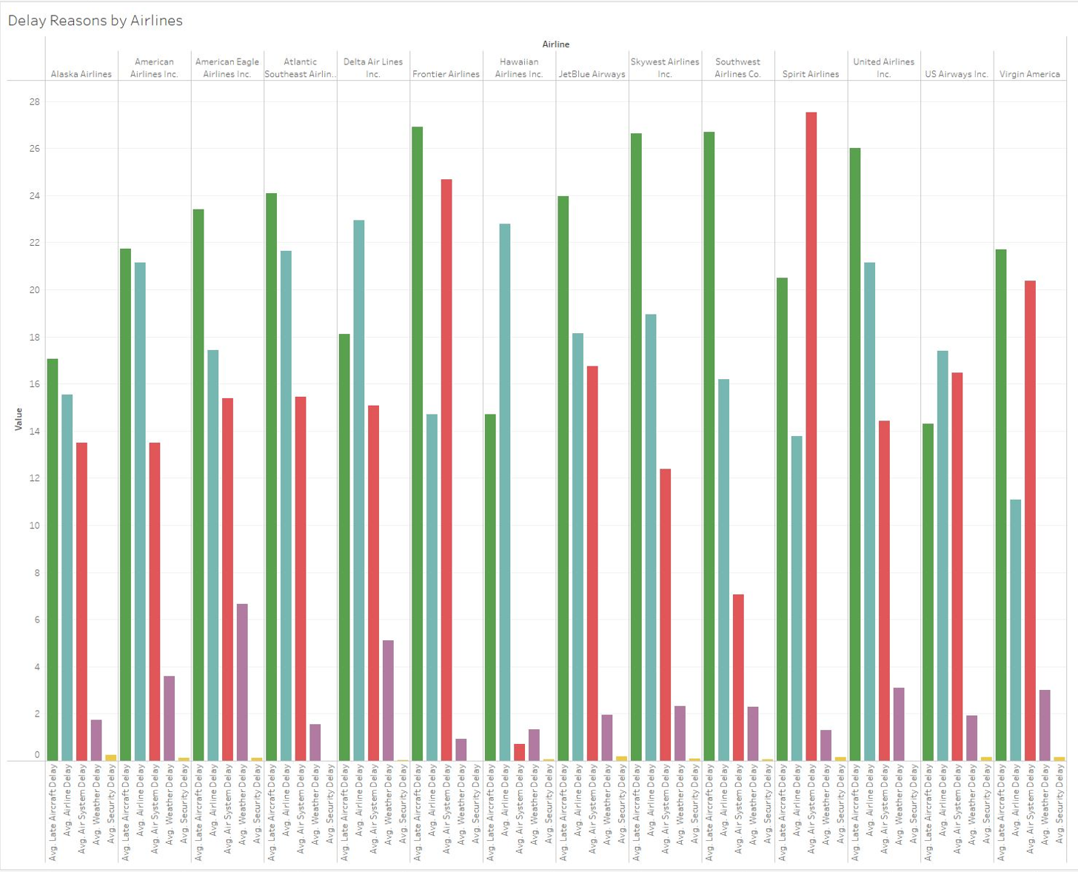
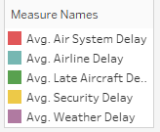

Slide 10
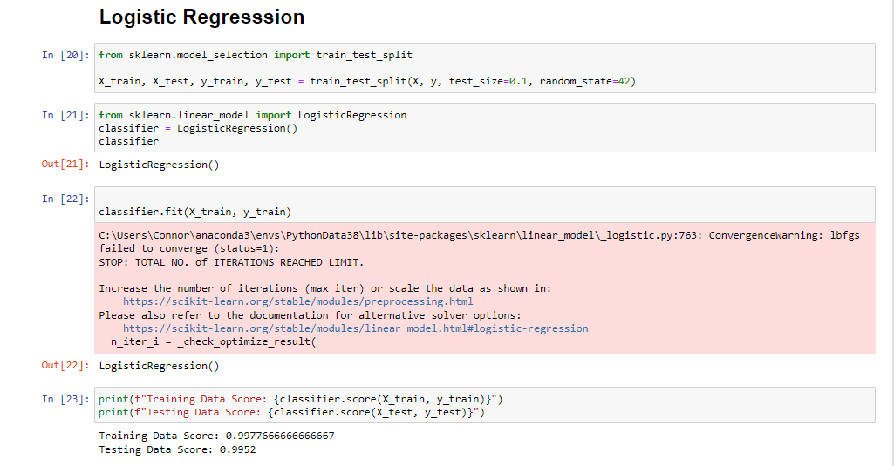
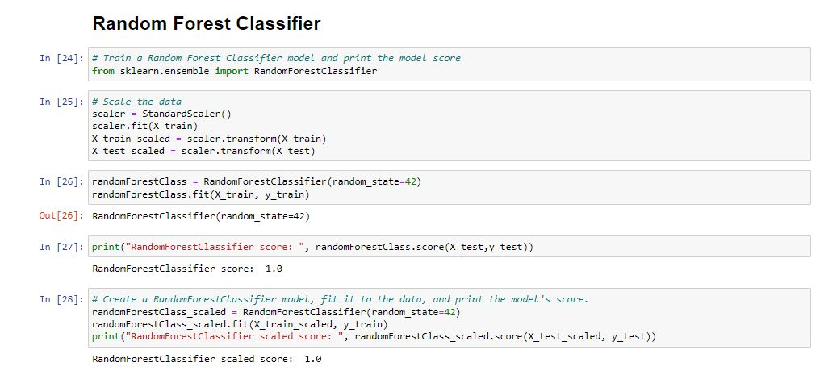
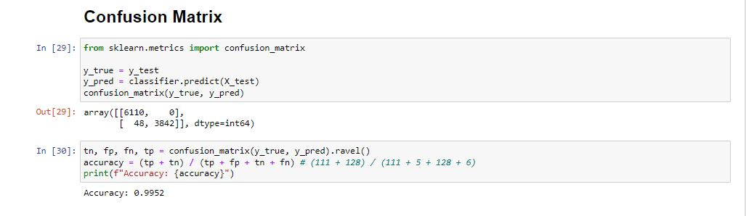
Models Used
Logistic Regression
Random Forest Classifier
Confusion Matrix

Slide 11
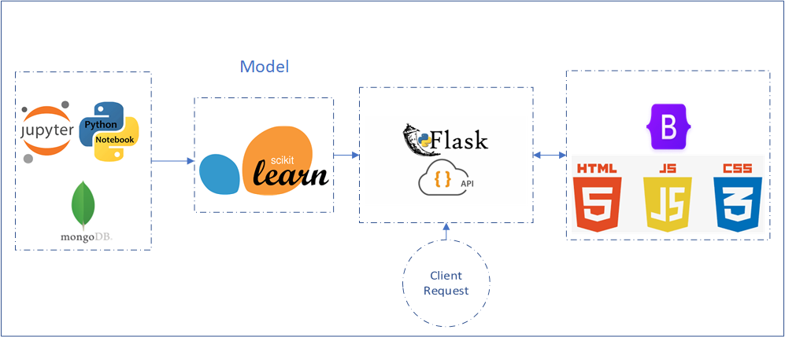
Flask ,Web page
Logistic Regression model
Save the model as pkl
Use it in flask
Got info from client
Make prediction
Prediction result on the screen
Notes:
A minimum viable product (MVP) is a version of a product with just enough features to be usable by early customers who can then provide feedback for future product development.
many factors could be added for more accuracy like weather and adding cancelation predictoin

Slide 12
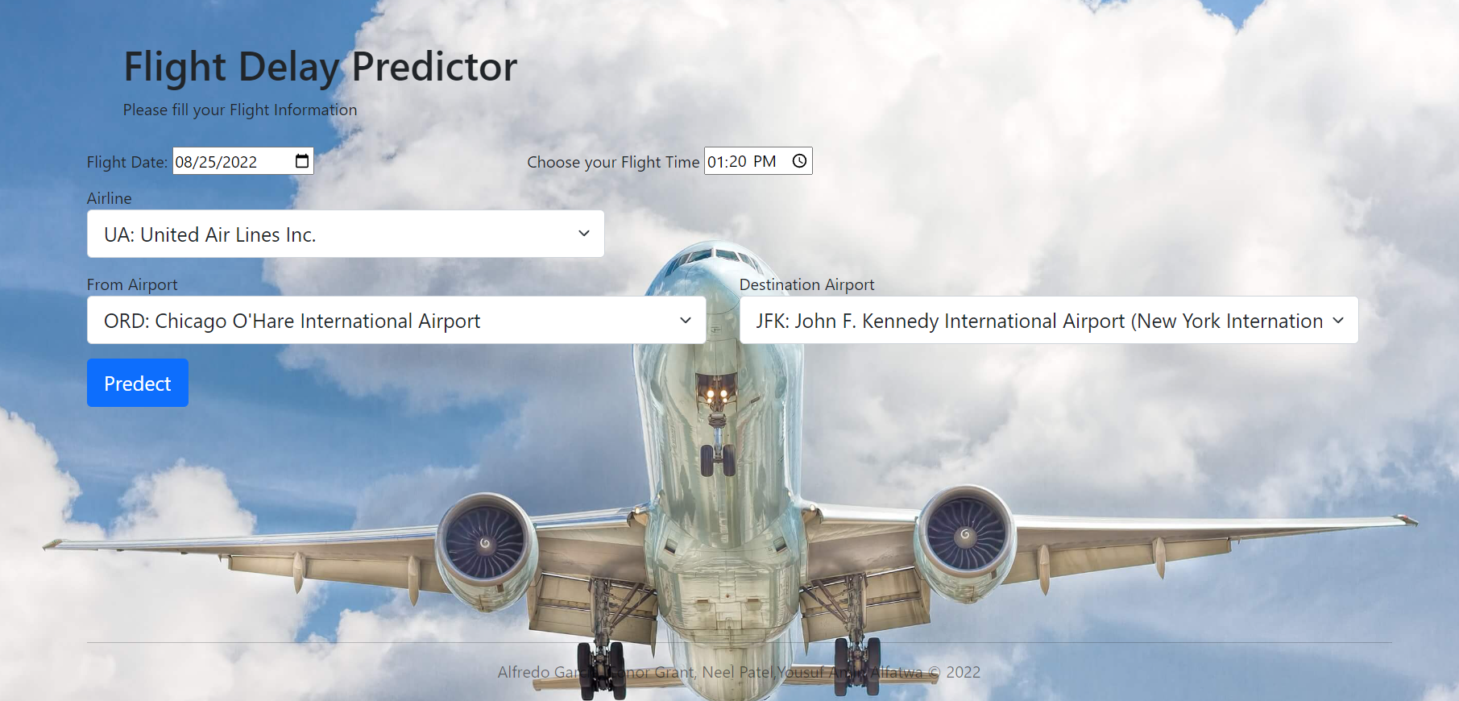
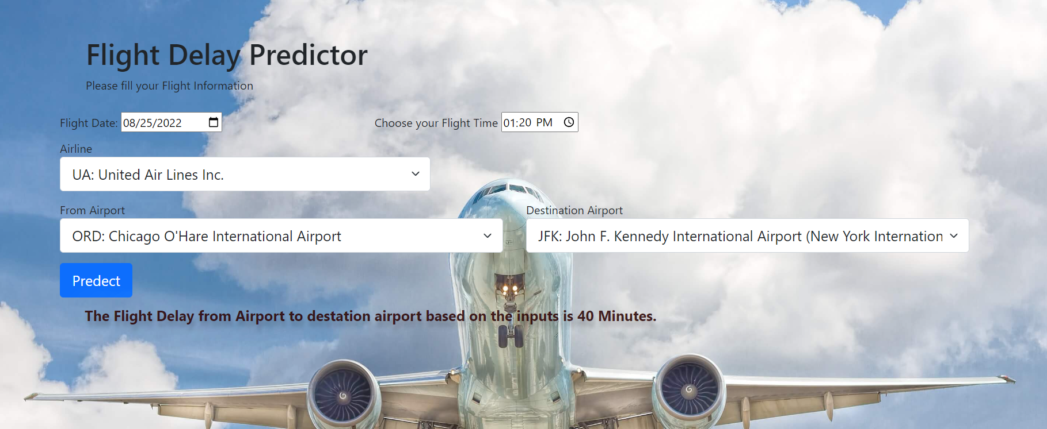
Flask ,Web page

Slide 13
Summary
Our prediction was that a Random Forest would produce a better prediction with our data. Random Forest are generally stronger with using categorical data, and given our cleaning and preparation, we had to convert our categorical data to numeric (airports, flight airlines, etc) which influenced this.
The results were very close, however, our prediction held true. Our Random Forest model did provide a stronger prediction (1.0), compared to our Logistic Regression model (0.9997).
The results of our data did show that Southwest Airlines (IATA: WN) is the airline with the highest amount of delayed flights, followed by Delta (IATA: DL), Skywest Airlines (IATA: OO), and Atlantic Southeast Airlines (IATA: EV).
The airports with the highest amount delayed arrival flights (IE: flight arrives past the original estimated arrival time) are: Denver (DEN), Atlanta(ATL), O’Hare(ORD), Dallas Fort Worth (DFW), Los Angles (LAX), and Phoenix AZ).
The day of the month did not have any direct correlation to a pattern of predicting delays, however, our data did suggest the 1st -> 5th and the 25th + 26th of each month had the highest counts of delays.

Slide 14
Lesson Learned
Our team came across hurdles throughout the project, but we continued to address and fix them in a timely manner.
We needed to reassess our data size (we bounced around from working with a full year, to only 3 months, ultimately to ending with 6 months). Our models would crash when trying to run due to such a high size, but we were able to work around this by using a random sample size when running our code. (shoutout to TA Erin for this suggestion!).
Assisting with changing factors in our dataframe columns for our Flask App and HTML prediction page to properly generate. (Changing data to numeric values, etc).
The amount of data used (6 months) could have an influence on our prediction models and their outcome, and future prediction models used could try to incorporate multiple years’ of flight data to provide further insight on these models.

Slide 15

Thank You!
Repo Link:

